Slide 1
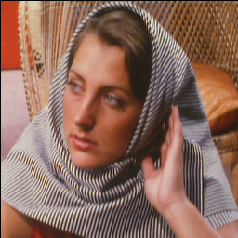
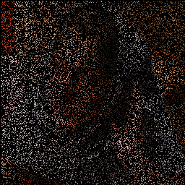

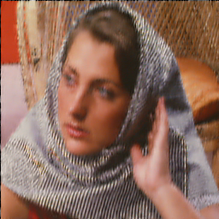

Experimental Results: Inpainting
Original
Degraded
FoE[7] PSNR = 23.67 dB
BP[48] PSNR = 25.70 dB
SGSR PSNR = 30.18 dB

Slide 2
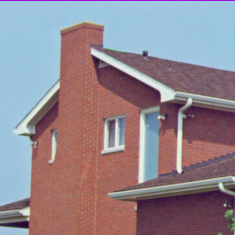
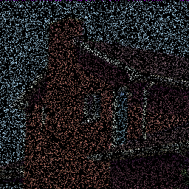



Experimental Results: Inpainting
Original
Degraded
FoE[7] PSNR = 32.64 dB
BP[48] PSNR = 30.89 dB
SGSR PSNR = 35.55 dB

Slide 3
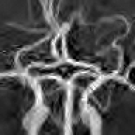
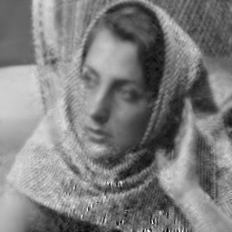
Experimental Results
Iteration Process of CS Recovery
Fig. 5: CS recovery process of proposed SGSR as the iteration number increases for Vessels and Lena in the case ratio=20%. Here, the initial result is generated by DWT.

Slide 4
组合优化与最优化 第1章 最优化方法示例
刘绍辉
计算机科学与技术学院 哈尔滨工业大学
shliu@hit.edu.cn
2025年春季

Slide 5
第1章最优化方法示例
面向插值的图像下采样
相机校正

Slide 6
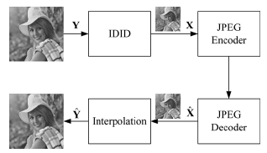

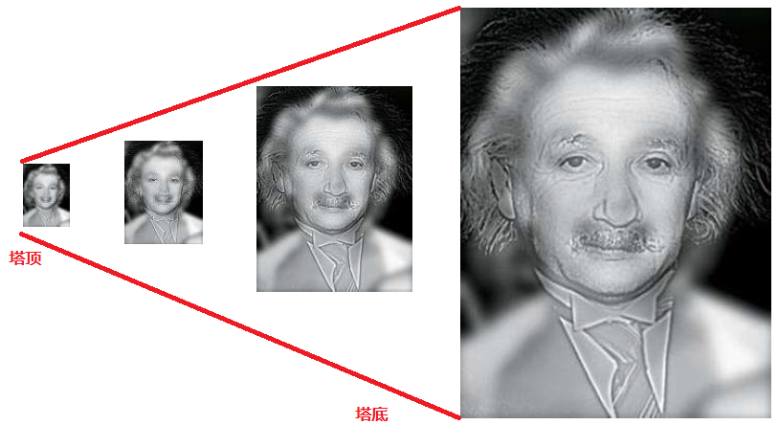
第1章最优化方法示例-面向插值的图像下采样
下采样

Slide 7
第1章最优化方法示例-面向插值的图像下采样
如何表示图像下采样
自适应下采样示意图
Yongbing Zhang, Debin Zhao, Jian Zhang, Ruiqin Xiong, and Wen Gao,interpolation-dependent image downsampling. IEEE TRANSACTIONS ON IMAGE PROCESSING, VOL. 20, NO. 11, NOVEMBER 2011
Yongbing Zhang, Jian Zhang, Ruiqin Xiong, Debin Zhao, Siwei Ma, Low Bit-rate Image Coding via Interpolation Oriented Adaptive Down-sampling, in Proceedings of SPIE Conference on Visual Communications and Image Processing, VCIP, Huang Shan, An Hui, China, Jul.11-14, 2010

Slide 8
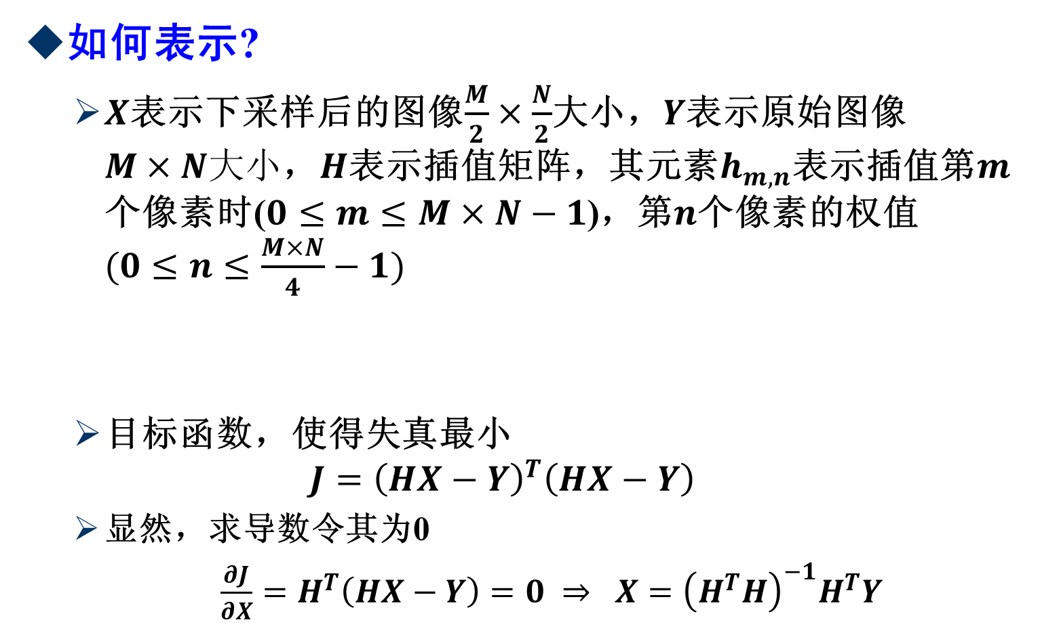
第1章最优化方法示例-面向插值的图像下采样
如何表示?
$X$表示下采样后的图像$\frac{M}{2}×\frac{N}{2}$大小，$Y$表示原始图像$M×N大小$，$H$表示插值矩阵，其元素$h_{m,n}$表示插值第$m$个像素时($0≤m≤M×N−1$)，第$n$个像素的权值$(0≤n≤\frac{M×N}{4}−1)$
目标函数，使得失真最小
$$J={\left(HX−Y\right)}^{T}\left(HX−Y\right)$$
显然，求导数令其为0
$\frac{∂J}{∂X}=H^{T}\left(HX−Y\right)=0$ $⇒$ $X={\left(H^{T}H\right)}^{−1}H^{T}Y$
$$Y=[Y_{0,0},Y_{0,1},⋯,Y_{0,N−1},Y_{1,0},Y_{1,1},⋯,Y_{1,N−1},⋯,Y_{M−1,0},⋯,Y_{M−1,N−1}$$
$$X=[X_{0,0},X_{0,2},⋯,X_{0,N−2},X_{2,0},X_{2,2},⋯,X_{2,N−2},⋯,X_{M−2,0},⋯,X_{M−2,N−2}$$

Slide 9
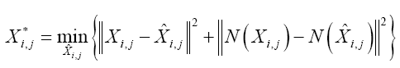
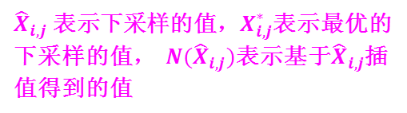
第1章最优化方法示例-面向插值的图像下采样
如何表示图像下采样-推广
自适应下采样的目的是在去除下采样图像混叠效应的前提下插值出高质量的上采样图像，因此 X 需满足
问题的形式化描述
${{\hat{X}}_{i,j} \text{表示下采样的值，}X}_{i,j}^{∗}$表示最优的下采样的值， $N({\hat{X}}_{i,j})$表示基于${\hat{X}}_{i,j}$插值得到的值

Slide 10
第1章最优化方法示例-面向插值的图像下采样
如何表示图像下采样
最优下采样的目标函数为
如何求解呢？令J的偏导为零
最优下采样图像为
代价函数
最优解

Slide 11
第1章最优化方法示例-面向插值的图像下采样
示意图
显然，EDI的插值系数矩阵取决于低分辨率图像的内容 ，但是IOIDS取决于EDI的插值系数

Slide 12
第1章最优化方法示例-面向插值的图像下采样
算法
内容相关自适应图像下采样算法

Slide 13
第1章最优化方法示例-面向插值的图像下采样
性能

Slide 14
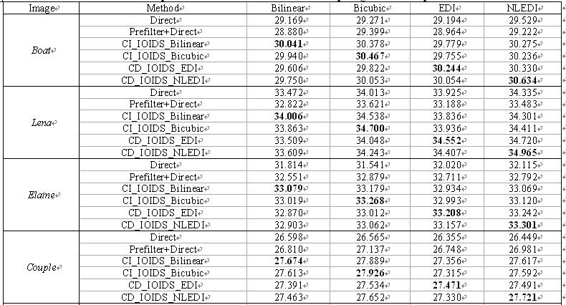
第1章最优化方法示例-面向插值的图像下采样
不同方法比较

Slide 15
第1章最优化方法示例-面向插值的图像下采样
后处理项
基于TV的后处理可以表示为

Slide 16
第1章最优化方法示例-面向插值的图像下采样
不同方法图像性能比较

Slide 17
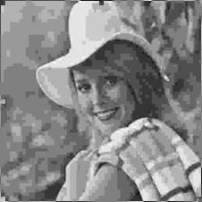

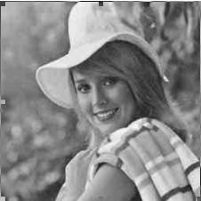


第1章最优化方法示例-面向插值的图像下采样
性能
JPEG 26.443dB
Direct_SAI29.748dB
Direct_TV_SAI30.087dB
IOIDS_SAI 29.843dB
IOIDS_TV_SAI30.218dB

Slide 18
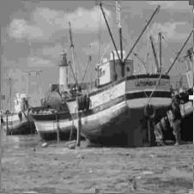
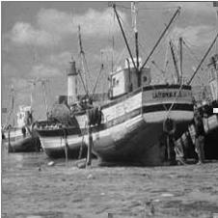
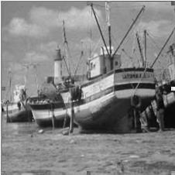


第1章最优化方法示例-面向插值的图像下采样
后处理项
JPEG 26.443dB
Direct_SAI29.748dB
Direct_TV_SAI30.087dB
IOIDS_SAI 29.843dB
IOIDS_TV_SAI30.218dB

Slide 19
第1章最优化方法示例-面向插值的图像下采样
面向插值的图像下采样
下采样过程如何数学形式化描述
如何形式化工程中的问题
设定目标准则
采用优化方法来求解

Slide 20
第1章最优化方法示例-相机校正
相机校正是计算机视觉中的经典问题

Slide 21
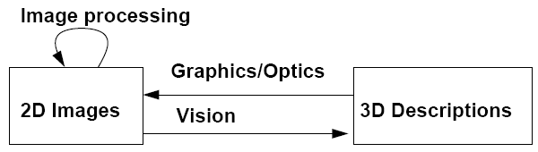
第1章最优化方法示例-相机校正:Main Problems in Computer Vision
Correspondence problem: match image projections of a 3-D configuration
Reconstruction problem: recover the structure of the 3D configuration from image projections
Re-projection problem: Is a novel view of a 3-D configuration consistent with other views?

Slide 22
第1章最优化方法示例-相机校正Shape from ‘X’
Reality world is 3-D
(X,Y,Z) denotes any point in this space
Image is 2-D
(X,Y) denotes any point in this image
It is obtained by the projection process
One dimension is lost
One of the important goals in CV is to recover this lost dimension
Recovering 3-D information from 2-D images are called shape from ‘x’
X: maybe stereo, motion, shading, texture, etc

Slide 23
第1章最优化方法示例-相机校正Translation and Scaling
Consider a point on an object: (X₁,Y₁,Z₁), assume that the object is translated by dx,dy, and dz respectively in the X, Y, and Z direction, then the new coordinates of the point are given by:
X₂=X₁+dx; Y₂ = Y₁ + dy; Z₂ = Z₁ + dz

Slide 24
第1章最优化方法示例-相机校正Translation and Scaling(Cont.)
T is called as translation matrix
Obviously, the inverse of T, T*T⁻¹=I, I is the identity matrix

Slide 25
第1章最优化方法示例-相机校正：Translation and Scaling(Cont.)
Similarly, if the object is scaled by factors S_{x},S_{y},and S_{z} respectively in the X, Y, and Z directions
X₂=X₁×S_{x}; Y₂ = Y₁ × S_{y}; Z₂ = Z₁ × S_{z}
It can be also written in matrix form:

Slide 26
第1章最优化方法示例-相机校正:Translation and Scaling(Cont.)
S is called as the scaling matrix
Obviously, the inverse of S, S*S⁻¹=I, I is the identity matrix

Slide 27
第1章最优化方法示例-相机校正: Rotation
Consider a vector whose endpoint is at (X₁,Y₁,Z₁), Let R denote the length of vector, and Φ denote the angle the vector makes with X-axis. Assume that the vector is rotated by the angle θ around the Z-axis in the counterclockwise direction, then the new coordinates (X₂,Y₂,Z₂) of the point after rotation can be computed from the old coordinates and the angle of rotation

Slide 28
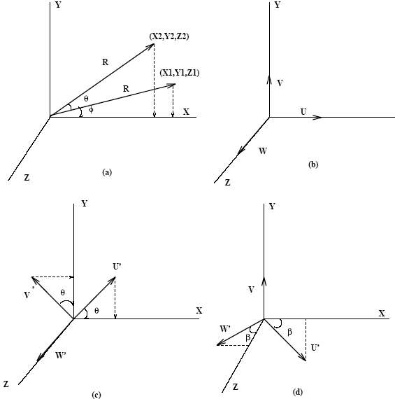
第1章最优化方法示例-相机校正: Rotation(cont.)
It is obvious
X₁=R cos Φ
Y₁=R sin Φ
X₂=Rcos(θ+ Φ)
=Rcosθcos Φ - RsinθsinΦ
Y₂=Rsin(θ+ Φ)
=Rsinθcos Φ +RcosθsinΦ
X2=X1cos θ-Y1sin θ
Y2=X1sin θ+Y1cos θ

Slide 29
第1章最优化方法示例-相机校正: Rotation(cont.)
These equations can also be written in matrix form:
The rotation matrix is:

Slide 30
第1章最优化方法示例-相机校正: Properties of the Rotation Matrix
θ and - θ
The inverse of a rotation matrix is just its transpose

Slide 31
第1章最优化方法示例-相机校正: An Alternate Way
Considering two coordinate systems
(X,Y,Z), (U,V,W)
Assuming that (U,V,W) are the unit vectors, then rotating the UVW coordinate system around the Z-axis by an angle θ, one can get the (U’,V’,W’)
Then it is obvious that: U’: (cosθ,sinθ,0),V’(-sinθ,cosθ,0), and W’:(0,0,1)
The rotation matrix can now be formed by putting the coordinates of the U’,V’, and W’ vectors respectively in the first, second and third columns, and (0,0,0,1)in the fourth column

Slide 32
第1章最优化方法示例-相机校正: Rotating the Coordinate System
It can be used to derive the rotation matrix around any axis
For example, the rotation matrix around the Y-axis in the clockwise direction is given by:

Slide 33
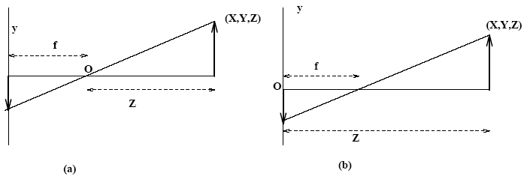
第1章最优化方法示例-相机校正: Perspective Transform
Pinhole camera model
The world coordinates(X,Y,Z) of a point are transformed to the image coordinates(x,y) under perspective projection, if the origin at the lens,
-y/Y = f/Z ➔ y = -fY/Z
-x/X = f/Z ➔ x = -fX/Z
If the origin at the image plane(in Fig.b)
-y/Y = f/(Z-f) ➔ y = fY/(f-Z)
-x/X = f/(Z-f) ➔ x = fX/(f-Z)

Slide 34
第1章最优化方法示例-相机校正: Can it be represented in matrix form?
Homogeneous transformation
Converts the Cartesian world coordinates(X,Y,Z) into the homogeneous world coordinates(kX,kY,kZ,k), it is noted that the fourth component is new
The inverse homogeneous transform
Converts the homogeneous image coordinates(C₁,C₂,C₃,C₄) into the Cartesian image coordinates (C₁/C₄, C₂/C₄,C₃/C₄)

Slide 35
第1章最优化方法示例-相机校正: The perspective matrix P
The perspective transform relates the homogeneous world coordinates with the homogeneous image coordinates :

Slide 36
第1章最优化方法示例-相机校正: The perspective matrix P
We can easily derive the Cartesian image coordinates from the mentioned equation:
The inverse perspective matrix is given by

Slide 37
第1章最优化方法示例-相机校正: Camera Model
The perspective transform relates the world coordinates with the image coordinates when the camera is located at the origin of the world coordinates. However, in real life we need to translate and rotate the camera in order to bring the object of interest in the field of view The complete camera model involves several other transformations besides the perspective transform

Slide 38
第1章最优化方法示例-相机校正: How to translate WHC to CIC
Assuming the world homogeneous coordinates (WHC) W_{h}, the camera image coordinates (CIC)C_{h}
The camera first locates the origin of the WHC, is then translated by(X₀,Y₀,Z₀)(matrix G), then rotated around the Z-axis by θ in the counterclockwise direction (matrix ), rotated again around the X-axis by Φ in the counterclockwise direction (matrix ), and then translated by (r₁,r₂,r₃) (matrix C). Hence, we have

Slide 39
第1章最优化方法示例-相机校正

Slide 40
第1章最优化方法示例-相机校正: The Cartesian Image Coordinates
Calculating these matrix multiplication

Slide 41
第1章最优化方法示例-相机校正: Camera Calibration
The camera model
The world coordinates -----The image coordinates
Assuming the camera focal length, rotation angles, and translation displacements are known
If these parameters are not known?
To use the camera as a measuring device to determine the unknowns in the camera model
It is called camera calibration
Some points in 3-D with Known coordinates and their corresponding image coordinates are used to calibrate the camera

Slide 42
第1章最优化方法示例-相机校正: Camera Calibration (cont.)
World homogeneous coordinates-> camera coordinates
Where A denote the camera matrix, the aim in the camera is to determine the matrix A using the known 3-D points and their corresponding image coordinates, 16 unknowns, however, C_{h3} is not meaningful in the image coordinates. The image is only 2-D. the image coordinates can be determined by other 3 components. Hence, the third row of A can be neglected. 16 – 4 = 12 unknowns
Different As corresponds to different camera models:
The projective camera; The perspective camera
The affine camera; The weak-perspective camera
The orthographic(parallel) camera.

Slide 43
第1章最优化方法示例-相机校正: How to solve the unknowns
As we know, the Cartesian image coordinates (x,y) are given by
According to C_{h} = AW_{h,}

Slide 44
第1章最优化方法示例-相机校正: How to solve the unknowns (cont.)
We obtain the two equations:
Where there are 12 unknowns, and five knowns
(X,Y,Z,x,y). It is obvious that one point pair give two such equations, n point pairs give 2n such equations

Slide 45
第1章最优化方法示例-相机校正: Equations
2n equations
where i = 1,…, n, it can also be written in matrix form

Slide 46
第1章最优化方法示例-相机校正
If it is denoted by CP=0, where C is a 2n*12 matrix, P is a 12*1 vector, and 0 is also a 12 *1 vector. This is a homogeneous system which has multiple solutions. Therefore, we can arbitrarily pick one of the unknowns, and determine the remaining unknowns. Let a₄₄ = 1, then

Slide 47
第1章最优化方法示例-相机校正
, D and R are known, then we can solve this system by pseudo inverse if at least 5.5 or more 3-D points and their corresponding image coordinates are known:
Once Q is determined, the matrix A is defined,
which completes the camera calibration

Slide 48
第1章最优化方法示例-相机校正: Recovering Camera Parameters
An interesting inverse problem deals with the recovery of camera parameters from the camera matrix. For example, given a photograph taken by an unknown camera from an unknown location which, has been cropped and/or enlarged, how can we determine the camera’s position and orientation, and determine the extent to which the picture was cropped or enlarged?

Slide 49
第1章最优化方法示例-相机校正: Applications of Recovering Camera Parameters
In autonomous navigation, a cruise missile could obtain the camera transformation matrix from a terrain model stored on-board and then compute the camera parameters that define the vehicle’s location and heading.
A stationary camera viewing a robot arm workspace could determining the position of the arm
The camera parameters can then be derived from the camera transformation matrix, and the location and orientation of the manipulator can be obtained relative to the stationary camera

Slide 50
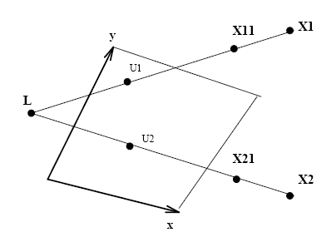
第1章最优化方法示例-相机校正: Camera Location
Consider a 3-D point X₁ with coordinates (X1, Y1, Z1). If camera matrix A is known we can determine the image coordinates of a point by using
If we multiply U₁ with A⁻¹, then we get the original X₁ back. If let the third component of U₁ equal 0, then U₁ ‘ = (C_{h1}, C_{h2},0, C_{h4}), then A⁻¹U₁’=X₁₁. We get a new 3-D point X₁₁, which should lie on the same line connecting X1 and the center of projection L, similarly, there exists another 3-D point X2, and generate X21, then we can easily determine L by the intersection of these two lines.

Slide 51
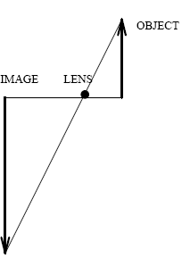
第1章最优化方法示例-相机校正: Camera Orientation
The orientation of a camera is defined as the orientation of the image plane.
The only way the image of a finite world point can be formed at infinity is if the fourth component of the homogeneous image coordinates is zero.

Slide 52
第1章最优化方法示例-相机校正: Camera Orientation (cont.)
Then it gives the following constraint on the camera orientation:
This is the equation of a plane passing through lens L parallel to the image plane. From this equation it is clear that (a₄₁,a₄₂,a₄₃) is the normal to the image plane, and parallel to the camera

Slide 53
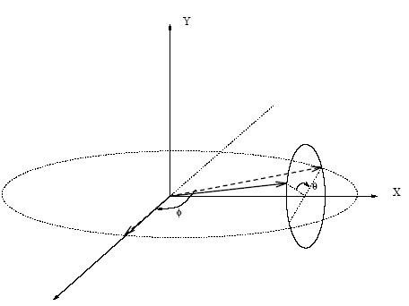
第1章最优化方法示例-相机校正: Camera Orientation (cont.)
The orientation in terms of clockwise rotation, θ, around the X-axis, followed by the clockwise rotation, Φ, around the Y-axis, is given by:

